Slide 1
Through a Speculum
Smart Mirror -
Alan Palayil, Fabian Garcia, Gabriel Gutierrez
ECE 441: Smart and Connected Embedded Systems
Advisor: Prof. Jafar Saniie

Slide 2



Team
Alan Palayil - B.S. Computer and Cybersecurity Engineering | Fabian Garcia - B.S. Computer Engineering | Gabriel Gutierrez - B.S. Electrical Engineering

Slide 3

Constraints
Cost
Raspberry Pi 4
Touch Frame
Computational Power
Limited to SD card storage and 4GB ram
Enclosure
MDF
Software
Personal Knowledge
Operating system’s compatibility
Have the whole project work as one cohesive unit for consumers.

Slide 4
Goal
Create a fun and interactive mirror that:
Functions as a real mirror
Displays the time and weather
Provide the current news
Allows access to a personalized calendar
Plays video and audio
Used for monitoring and security
This mirror allows for a fun and more interactive experience

Slide 5

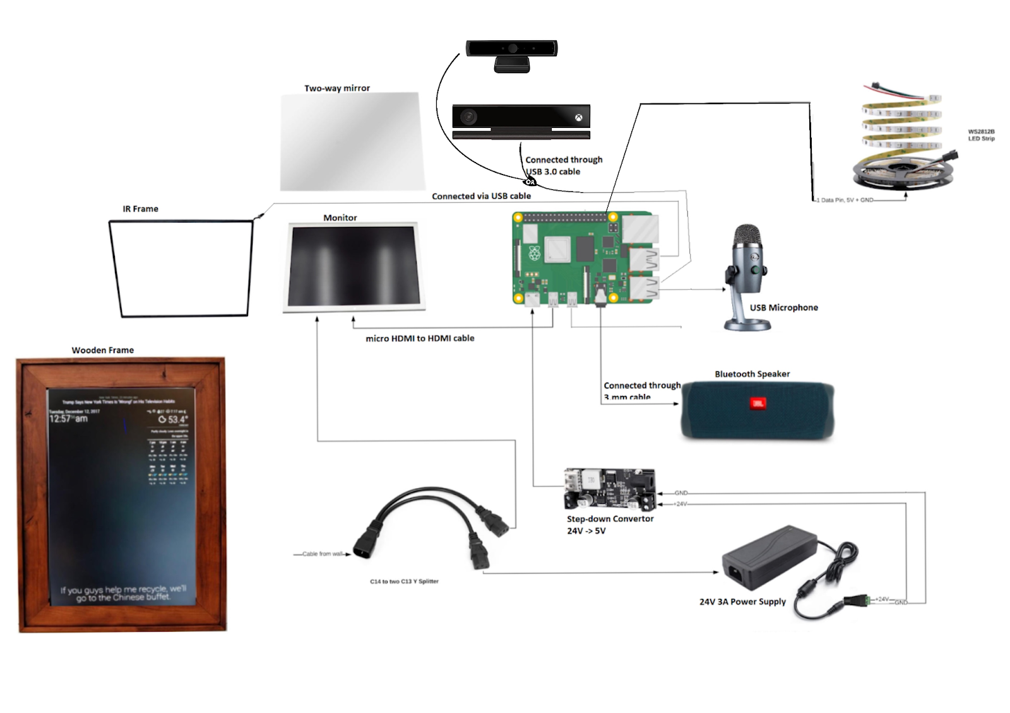
System design
Hardware Components included:
Raspberry Pi 4B
24V Power Supply
Voltage Converter
24in TV Display Panel
Two-Way Acrylic Sheet
IR Touch Frame
Camera module
Speaker and Microphone
Wooden Frame and Housing

Slide 6
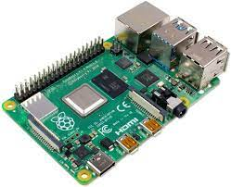
Raspberry Pi 4
The Raspberry Pi 4 was used for it’s computational power and IO ports. We wanted to use the Pi for the following reasons:
The 3.0 USB ports to connect the IR Touch Frame and camera module.
The micro-HDMI port to connect the TV Display for output.
The GPIO pins to add physical buttons capabilities.

Slide 7
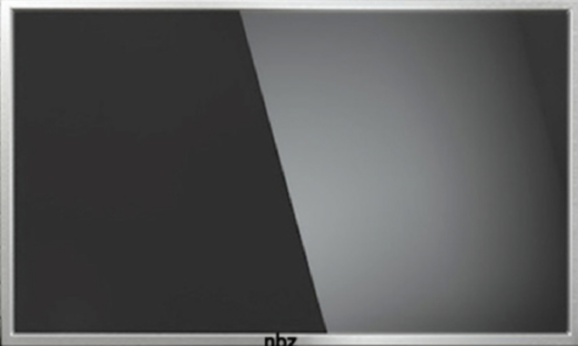
Display
Display consists of a 24 inch TV Display
The display was stripped of the housing in order to form a compact design.
Motherboards and components were placed throughout custom housing.
Connected to the Pi via the micro-HDMI to HDMI cable.
The brightness was adjusted for clear view through the two way sheet.

Slide 8
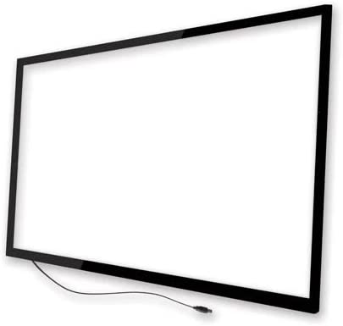
IR Frame
24 inch USB device that allows for touch inputs from the user.
Allows taps, swipes, and multi-finger inputs
Connected via the USB 3.0 port.
Overlays our display and the reflective acrylic sheet that acts as the two way mirror
Selected for easy cutting and breakage.

Slide 9
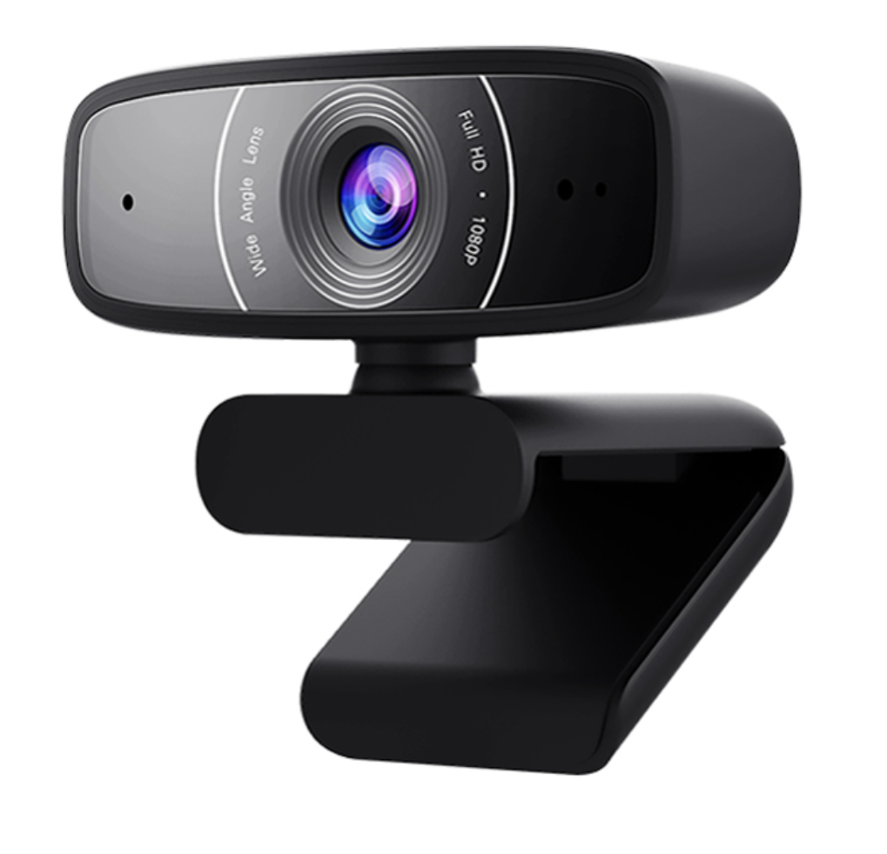
Camera Module
We attached a USB camera module for the primary purpose to add monitoring and surveillance.
The camera is integrated with the OS for motion tracking, video-calling, etc.

Slide 10
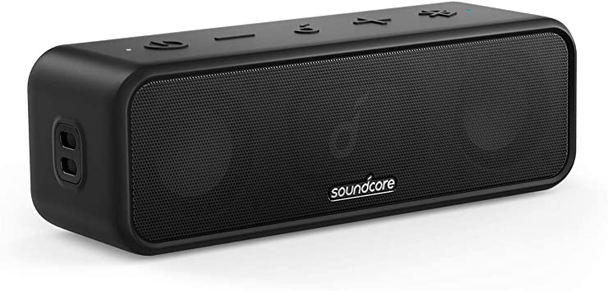
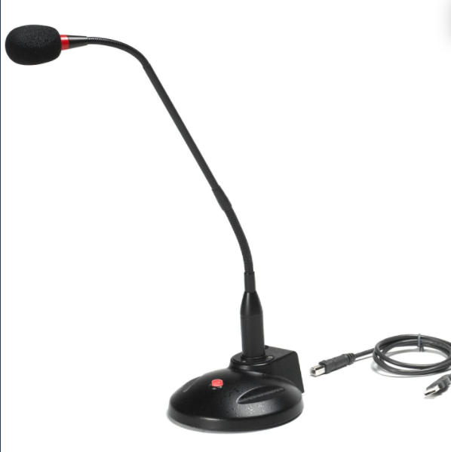
Speaker and Microphone
We selected the Anker Soundcore 3 for its sound quality.
Connected via the AUX cable to the Raspberry Pi
We stripped through the housing to attach it to our enclosure and reroute the buttons to the outside.
We selected a USB microphone with a physical mute button.
Connected via the USB 2.0 port and the mute button rerouted to the outside of the enclosure.

Slide 11
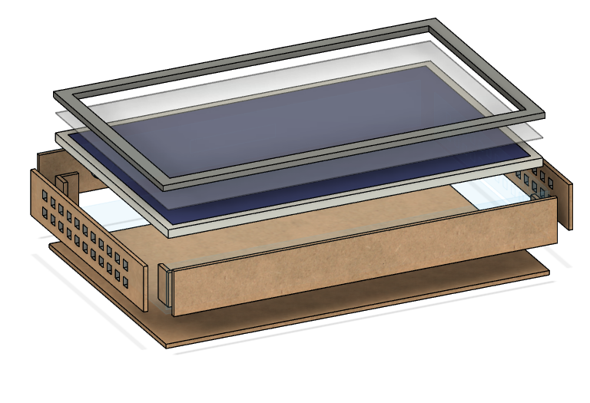
Enclosure
The smart mirror enclosure must:
Be compact
Be durable
Have ventilation
Be cost effective
House all the components

Slide 12

System OS
Initially we were using the Magic Mirror through Linux but due to low integration with the hardware components and features we wanted to include, we switched to an Android OS based on Raspberry Pi.
The Android OS included most of the features we wanted to include along with a easy user interface. Features included:
Google and Alexa voice services available.
Have additional applications added without difficulties.
Use GPIO pins for physical buttons.

Slide 13



Softwares Implemented
The softwares implemented on our project include:
Google Voice Assistant and Google Services.
Alexa Voice Services.
Warden Cam for monitoring and security.
Spotify, Google Music, Apple Music, and YouTube for recreation.
VNC is setup default in the OS and can be used for remote access.
IFTT and Amazon home to make the device as an IOT hub.

Slide 14
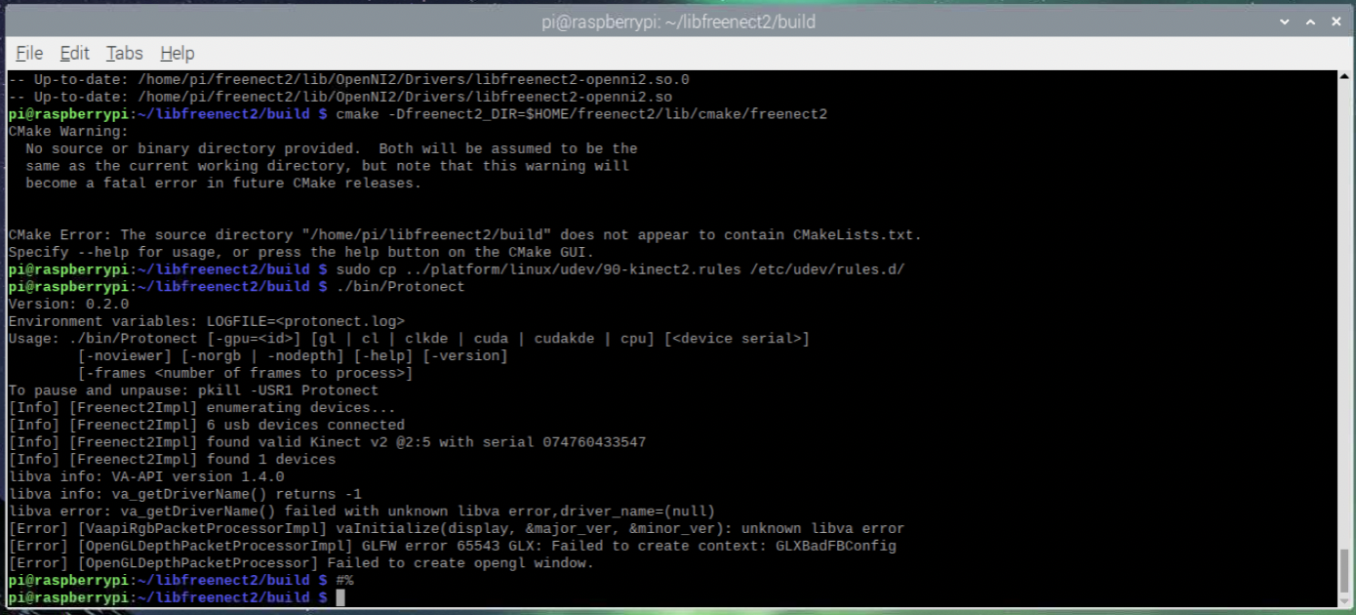
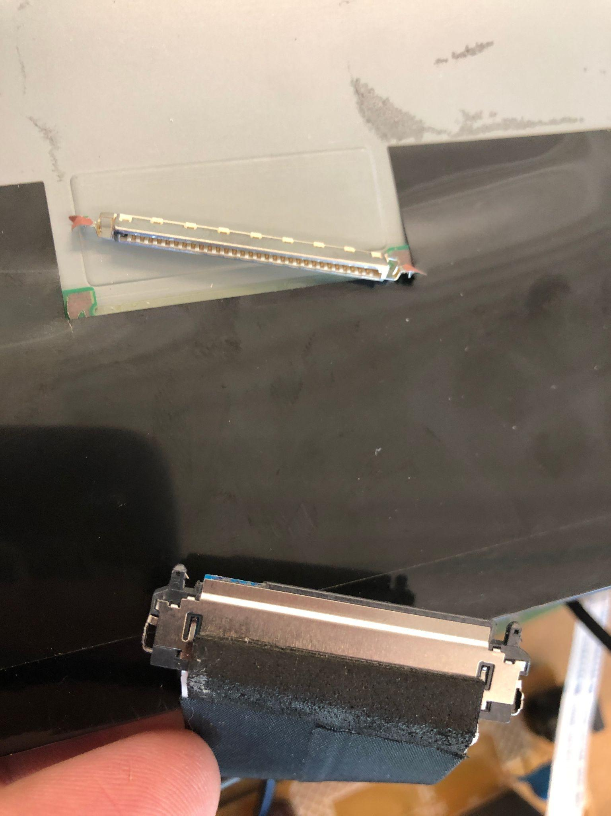
Technical Challenges
Raspbian magic mirror program
AVS and Google Assistant weren’t able to run.
Difficult set-up and future configuration.
Alexa Voice Assistant
Became incompatible after an official update.
XBox Kinect Gesture control
Compatibility issues with graphics driver of Raspbian.
Broken monitor
Ribbon cable slot broke off during assembly.
Incompatible Replacement Monitor
Replacement monitor was too old. Video was not able to be processed since it was out of the processing frequency.
The enclosure dimensions were off because of the replacement of the display.
Monitor’s broken
display cord

Slide 15
Future Work and
Application
Room Security System
Add motion sensor to active the camera for either video or picture.
Custom security system that can detect movement and report back to the owner can work in the background.
Have bluetooth integration to activate the camera when the user is away.
IoT Hub
Allows connection and control of other IoT devices through either GPIO pins or to display it in the Home Screen.
Virtual Assistant that can be tailored for user needs such as home assistant, workout trainer, etc.
Open Design System
Through Android OS, the user can create personalized applications to suit their needs

Slide 16
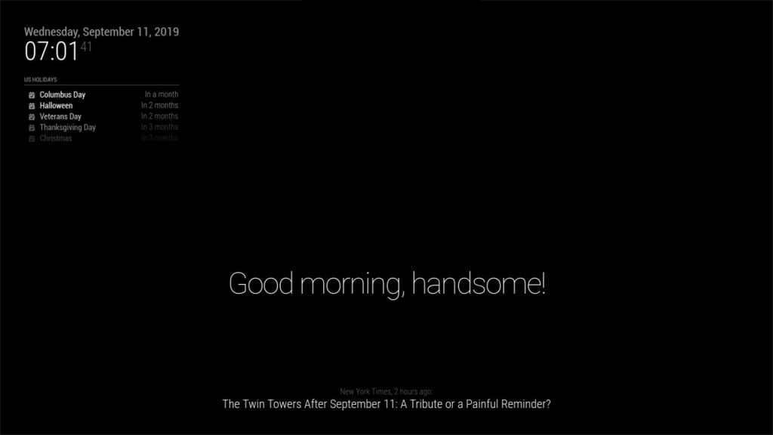

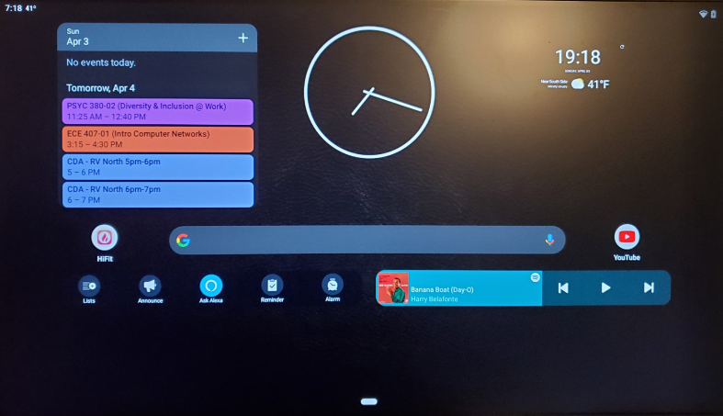
Conclusion
Old
Mirrors can be fun and have a lot of potential.
Privacy is an important aspect and physical buttons to disable inputs can improve user’s comfort.
Mute microphone
Disable Camera
Plans change
To have the features we discussed, we took a major step back and started back from scratch.
Technical challenges happen
Things break
Buggy Software
New

Slide 17
Individual Contributions
Alan | Gabriel | Fabian
Voice Assistants Implemented operating system Implement spotify | Researched face recognition for photo booth apps Created enclosure model Found a compatible security camera app | Researched linux and the initial Xbox kinect integration Found compatible android widgets for the operating system
Everyone
Constructed main assembly Troubleshooting and testing

Slide 18
Thank you!

